Slide 1



SUPPORTLYTICS — IT Support Performance Dashboard
Milestone 4 | Module 7: Dashboard & Report Preparation
1
2
Dataset
Dashboard Focus
200,000 customer support tickets
Workload analysis · Resolution performance · Cluster intelligence · Operational insights
3
Tools
Python · Machine Learning · Power BI

Slide 2
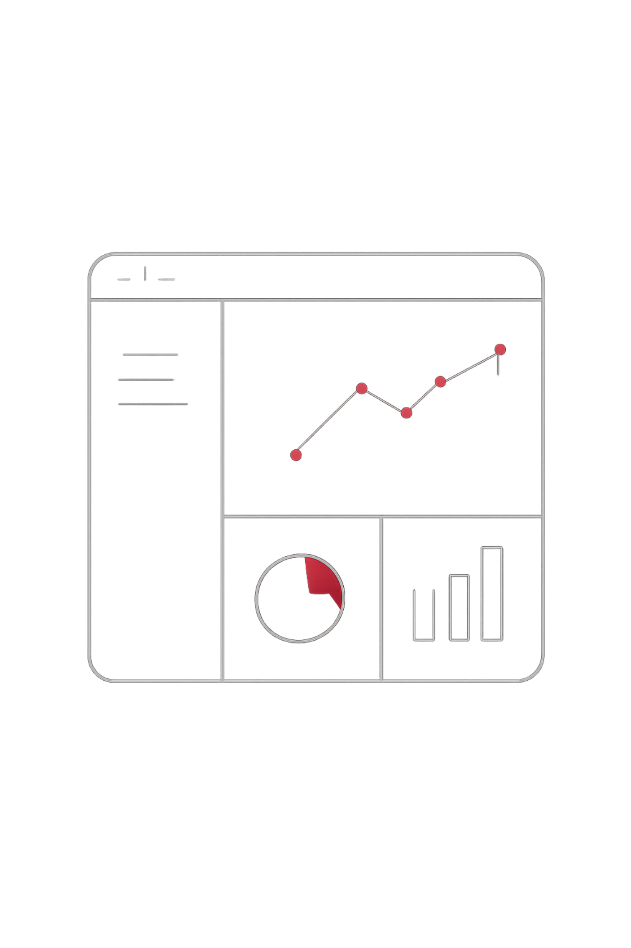

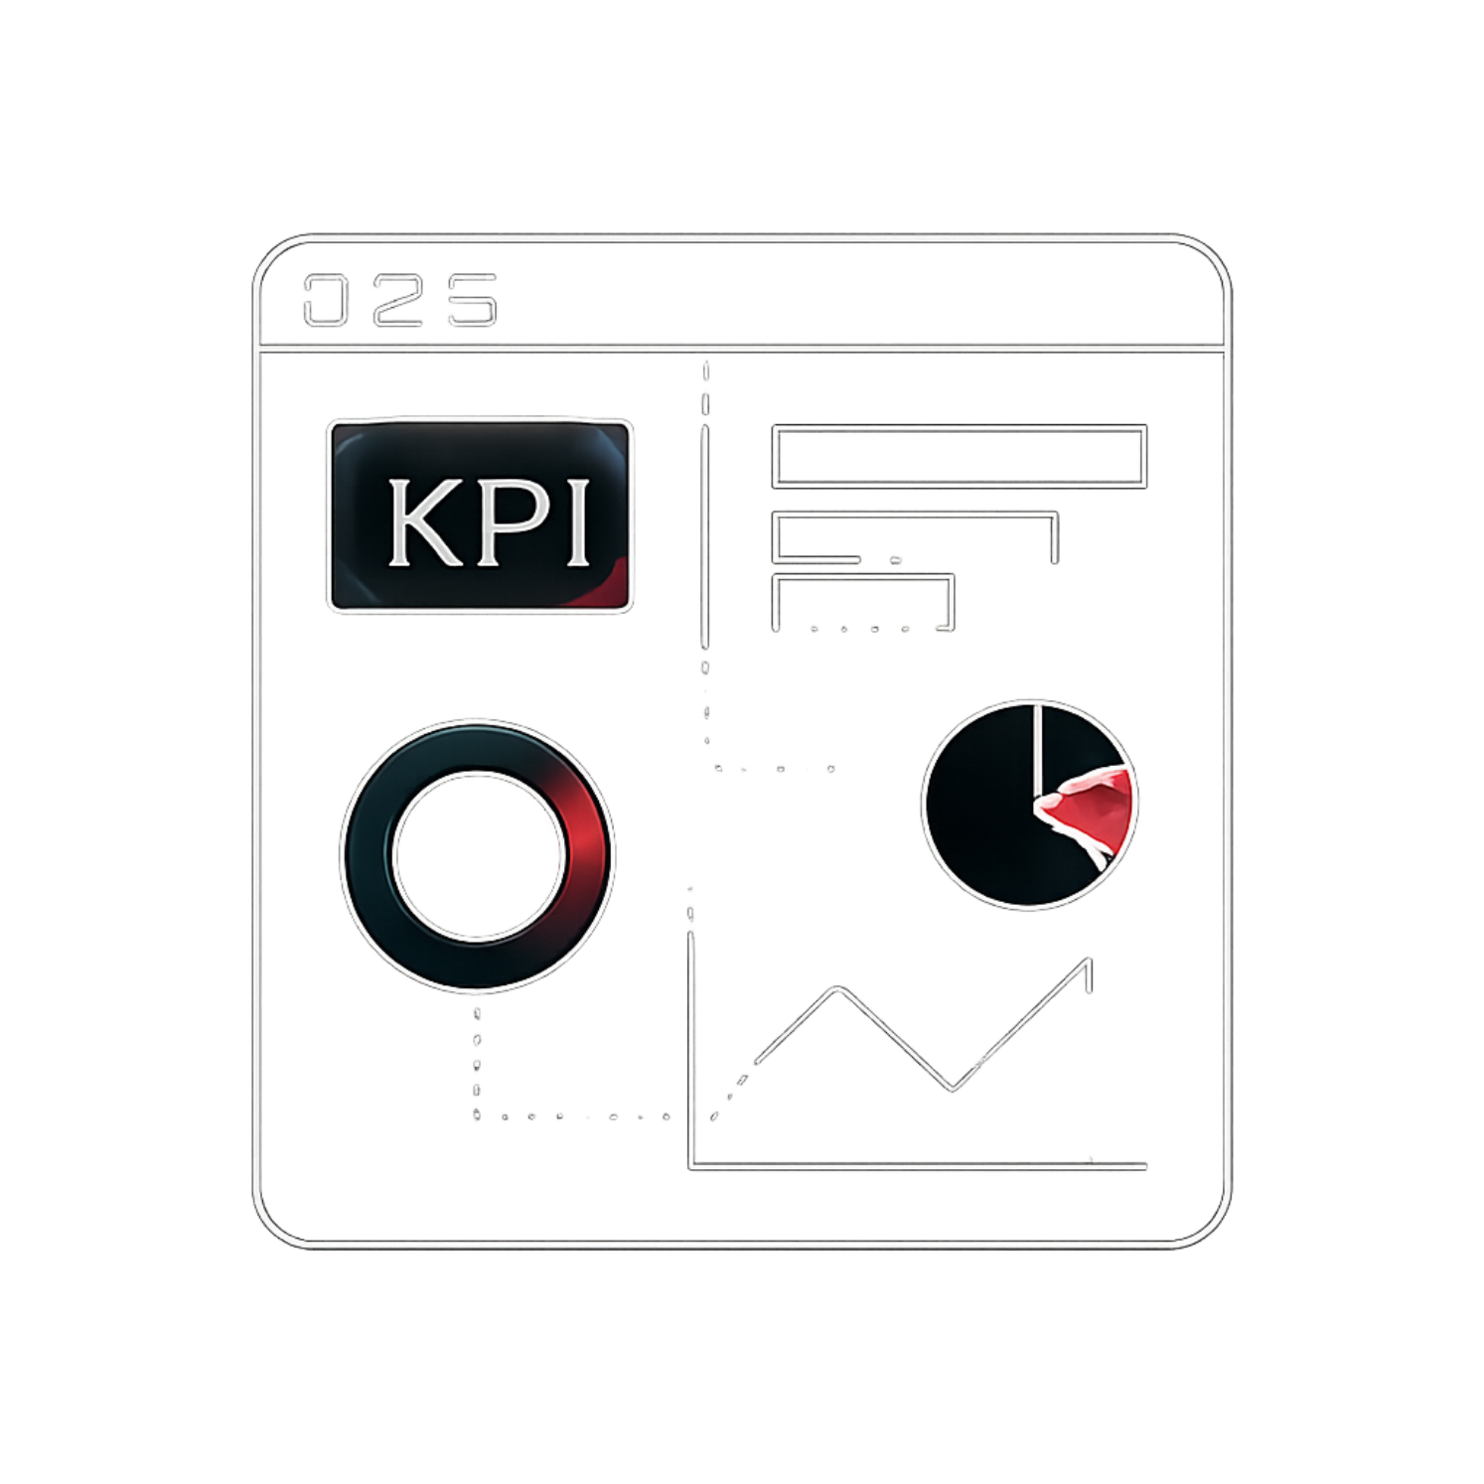

Dashboard Overview &
KPIs
The Power BI dashboard integrates analytic results into an interactive performance monitoring system, providing a quick overview of workload, service performance, clustering quality and customer experience.
Total Tickets: 200,000
Average Resolution Time: 120.54 hours
Average Cluster Similarity: 0.68
Average Customer Satisfaction: 3.00
High‑Priority Unresolved Tickets: ~80K*
Use the exact values shown in your corrected dashboard.

Slide 3


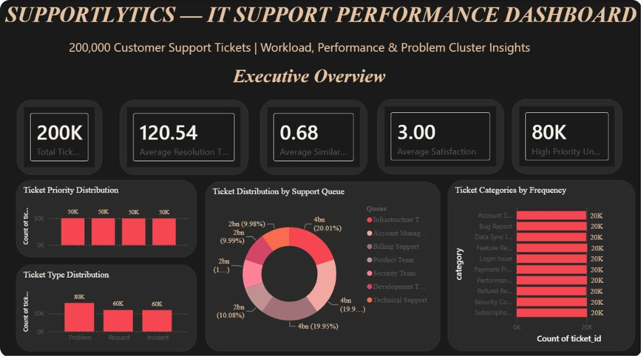




Executive Overview
Ticket Types
Priority
Problem ≈ 80K; Requests ≈ 60K; Incidents ≈ 60K
Low, Medium, High, Urgent — almost evenly distributed
Support Queue
Category
Account Management, Infrastructure, Billing Support handle highest volumes
Most categories ~20K tickets — workload is broad
Key insight: Problem tickets are the largest type and the workload is broadly distributed.

Slide 4
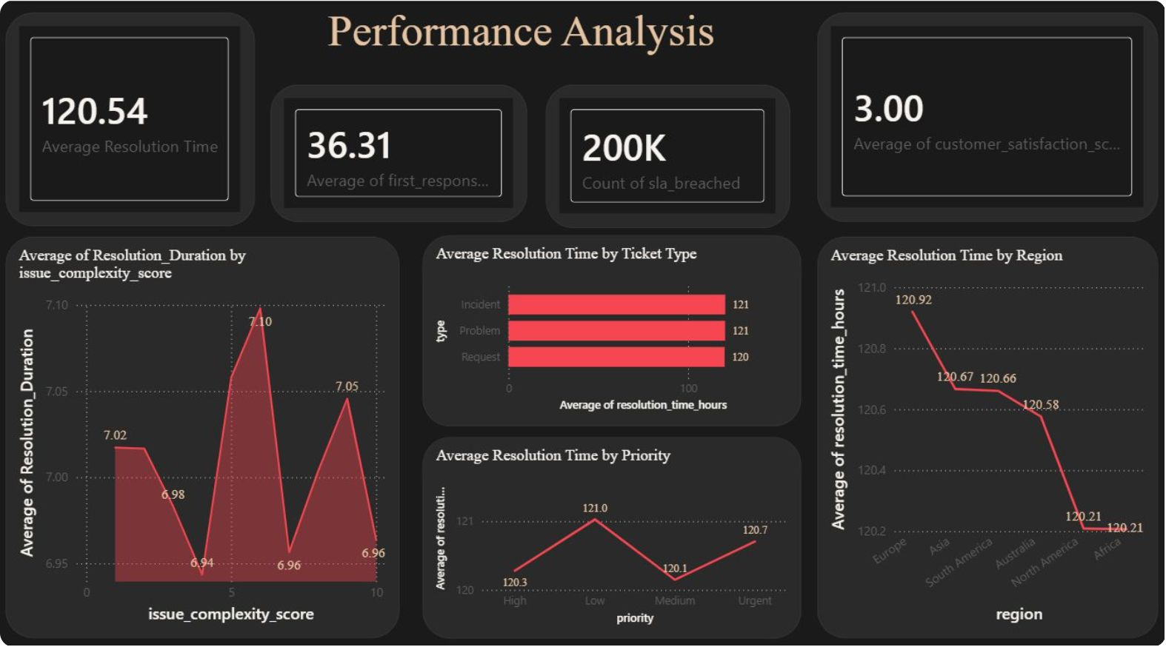


Performance Analysis
Resolution performance is relatively stable across complexity, ticket type, priority and region, but differences exist that point to improvement opportunities.
Key insight: Use regional and ticket-level variance to target improvements.
01
02
03
Issue Complexity
By Ticket Type & Priority
Regional Variation
Resolution time shows no strong upward trend with complexity.
Comparison highlights which types and priorities need more effort.
Africa & North America show lowest average resolution time; Europe the highest.

Slide 5
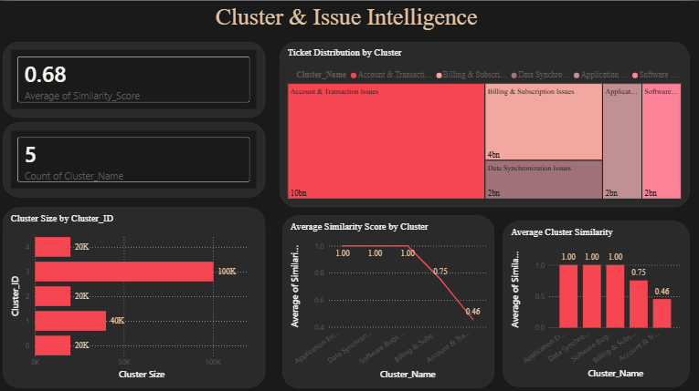

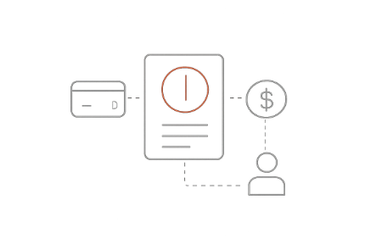
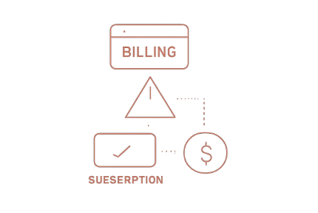
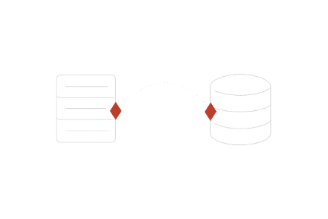
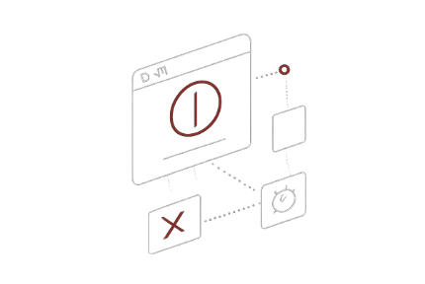


Cluster & Issue Intelligence
Machine learning clustering identified five major issue clusters. Similarity analysis indicates most clusters are well-defined, with one notable exception.
Overall cluster similarity: 0.68. Account & Transaction Issues are dominant.
Account & Transaction Issues
Billing & Subscription
Data Synchronization
Application Errors
Software Bugs & Updates
~20K tickets.
~100K tickets; similarity 0.46 — highest diversity; largest operational focus.
~40K tickets; high similarity.
~20K tickets.
~20K tickets.

Slide 6
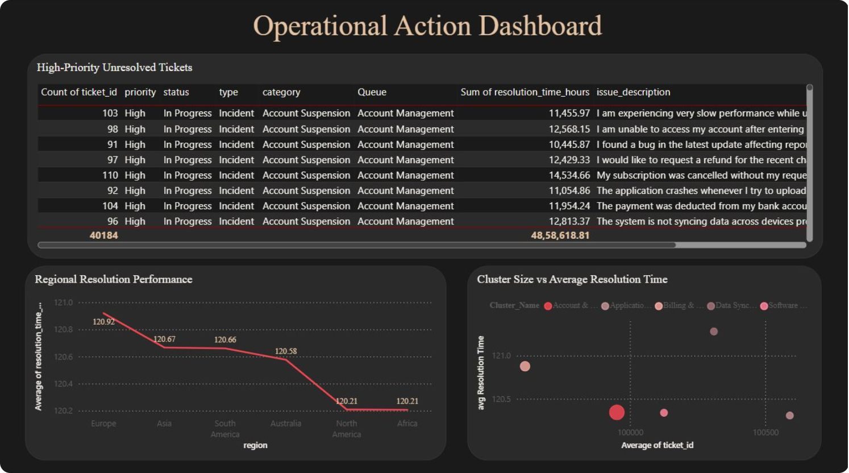





Operational Action Dashboard
The operational dashboard turns analytics into action by highlighting unresolved high‑priority tickets, regional performance, and cluster workload vs resolution time.
Key insight: Dashboard provides actionable information for teams and management.
High‑Priority Unresolved
Regional Performance
Cluster Size vs Resolution
Identifies tickets still open or in‑progress with ticket‑level details for rapid triage (~80K)
Compares average resolution time to find faster and slower regions
Highlights high‑volume clusters needing operational attention

Slide 7
Dashboard Insights
Workload
200K customer support tickets analysed
Resolution
Average resolution time: 120.54 hours
Frequent Issues
Account & Transaction Issues form the largest cluster (~100K)
Clustering
Average similarity score: 0.68
Customer Experience
Average satisfaction score: 3.00
Regional Performance
Africa & North America show the lowest average resolution time; Europe the highest
Operational Focus
High‑priority unresolved tickets require immediate attention
The Power BI dashboard delivers an interactive, single‑view environment for workload, performance,
cluster intelligence and operational priorities.

